Slide 1
Which baltic car dealership Has the most value potential?
Comparison between developed and developing countries in the EU

Slide 2
Presentation structure
Dataset overview
Industry analysis
Baltic country analysis
Search for the best performing firm
Potential deal evaluation

Slide 3
Overview
Observed
Comparison
Baltics
Developing
Developed
Nordics
4434 COMPANIES
Latvia
Estonia
Lithuania
Ukraine
Romania
Poland
Hungary
Croatia
Slovenia
Slovakia
Czech Republic
France
Germany
Austria
Norway
Finland
Sweden

Slide 4
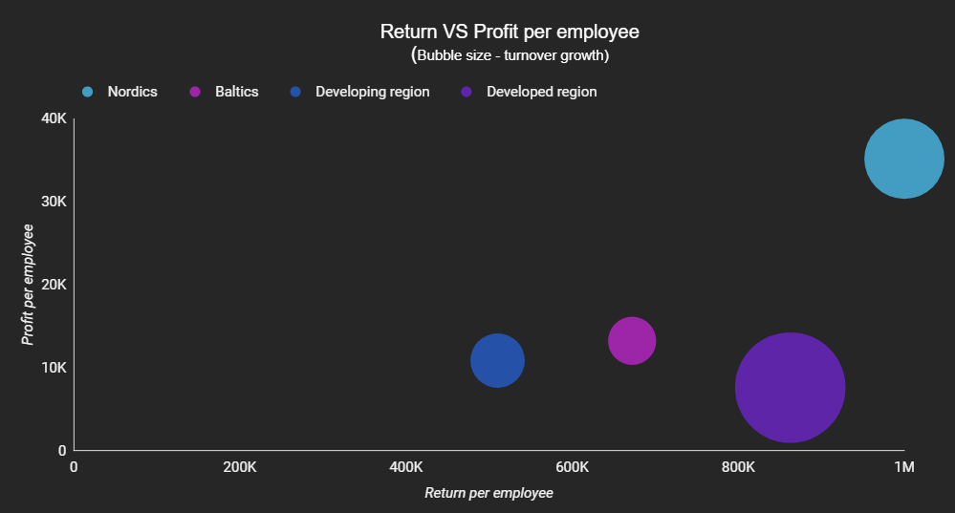
Industry analysis
Nordics – the clear leader in performance
Rest of the regions in comparison are underperforming
Baltics – despite the lowest Average turnover, beats developing region in employee efficiency.
Notes:
When we look at a chart where a relationship between revenue and profit it can be observed, that Nordics is a clear leader, while the rest of the regions are underperforming, possibly due to bad management.
The image also creates an impression that investment in developed regions would make the most sense, because of the high upside potential, but most car producers are from developed regions in the EU, therefore there are more direct factory dealerships. This would mean that potentially dealerships are not as interested in profits, since that is only a subsidy of a bigger car producer. Therefore, going into a developed market could be considered too risky since a normal dealership can’t compete with direct manufacturers’ dealerships.

Slide 5
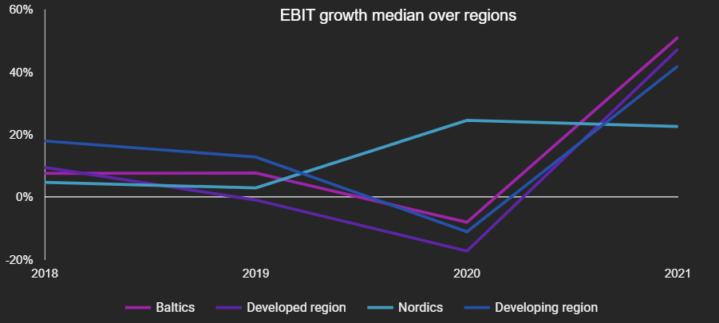
Industry analysis
Developed regions – too many obstacles to enter, EBIT growth not appealing.
Baltic businesses – best from the rest in the COVID-19 crisis.
Notes:
From the graph, Baltic and developing country dealerships seem to be the ones with the most potential in the future market, at the same time having less effect on market shocks like COVID-19 which is the reason for the 2020 growth decrease compared to developed EU country performance.

Slide 6
Baltic Country analysis

Slide 7
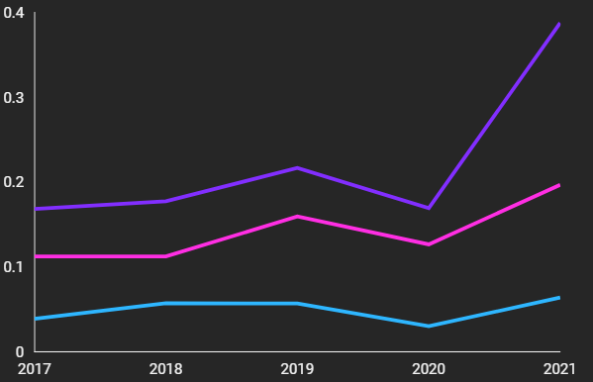
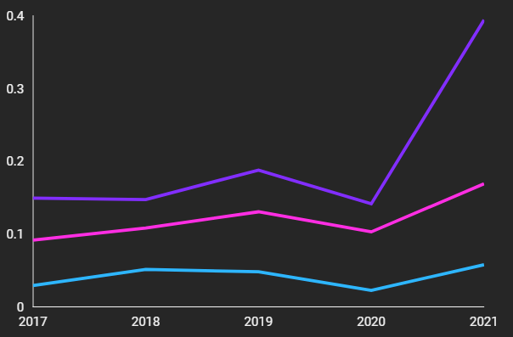

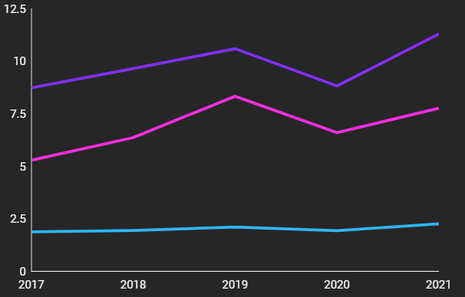
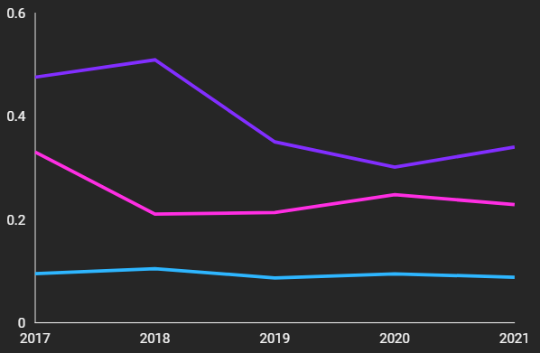
Financial measures per capita:
EBIT
Profit and loss
Turnover
L-t debt
Notes:
When we divide the average financial scores over Baltic countries by population, to get the average amount of cash a business is getting from each person, we get this kind of picture. Can you see some significant pattern that stands out?

Slide 8
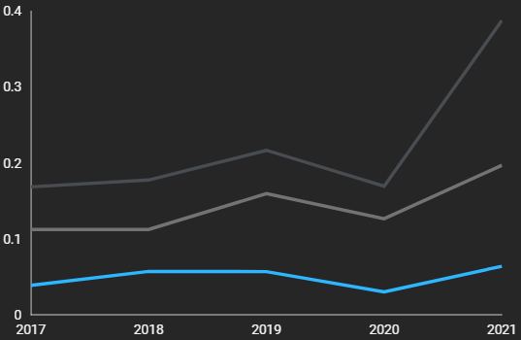
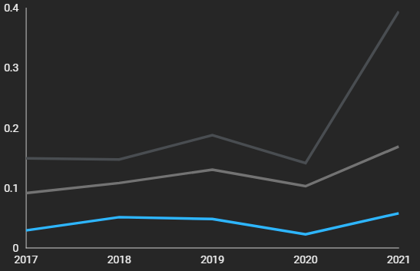

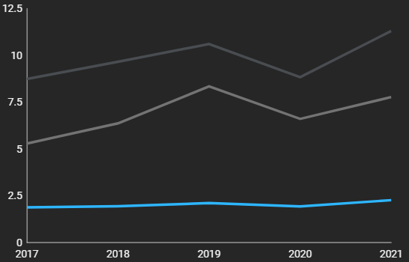
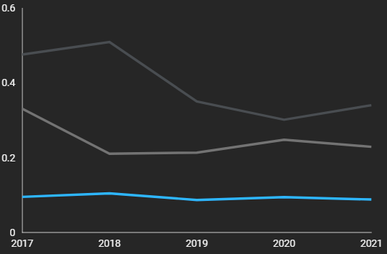
Financial measures per capita:
EBIT
Profit and loss
Turnover
L-t debt
Notes:
Latvia is seriously falling back behind Lithuania and Estonia in almost every revenue metric and in long-term debt levels as well. Potentially meaning that in Latvia the profits are more distributed among little firms leading to more competition, therefore, creating an process that would lead to harsher conditions for a single firm to become a leader. But… Why has this happened?

Slide 9
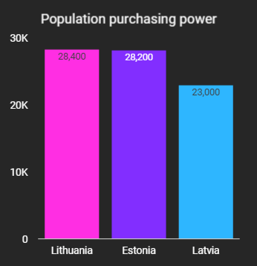
Country analysis
Latvia – 5 thousand lower purchasing power for the average resident.
Notes:
This result is partly influenced by Latvia having worse purchasing power than the rest of the Baltic countries, which is 5 thousand EUR lower than the rest of the Baltic countries.
But since this gap isn’t as big as represented in previous graphs, this would indicate that there is a possibility that Latvia actually has a better growth potential that is better than the rest of the Baltic countries, but at the same time that is only a guess while these lower revenues could at the same time be an indicator of poor demand and purchasing power of Latvian citizens. Therefore, if a PE firm is really risk-tolerant, the analysis should be continued deeper in LV countries as well, but in this case I think that this move is too big of a risk, considering other Baltic countries provide safer options.

Slide 10
Country analysis
Return on assets – PE firms usually come with a big capital introduction.
Worker efficiency: revenue and profit per employee (although not as important)
Main analysis measures taken:
Notes:
Private equity companies usually change 2 things: first is to increase the money available for the company and the second one is to change the company structure to make the business more profitable with the experience, expertise, and professionals PE funds operate with.
After running an OLS regression, it became clear that asset amount has a significant and positive impact on the firm.
Since productivity from assets are harder to change and PE companies usually rely a lot on capital introduction, return on asset measure, or simply how well the firm operates with their available resources was looked at. As a second measure, working efficiency: as in profit per employee, and revenue per employee was observed. These processes can be changed and upgraded of course, so it doesn’t hold as much weight as return on assets, but it is a perfect match if a firm already has it, despite sacrificing some potential value along the way..

Slide 11
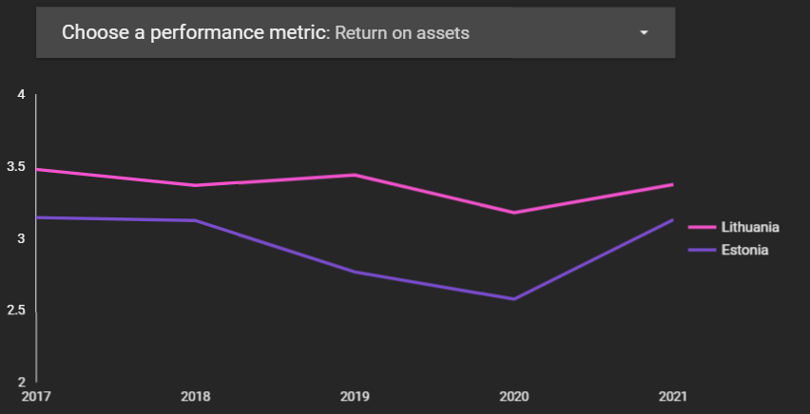
Country performance measures
Notes:
Therefore, this is the graph that is the most important comparison: return on assets between EST and LT over last 5 full years.
Lithuania is much better in return per assets measure over the years and is more stable in pandemic times.
But by taking a look at the other measure, the conclusion of the best country seems to be contradicting.

Slide 12
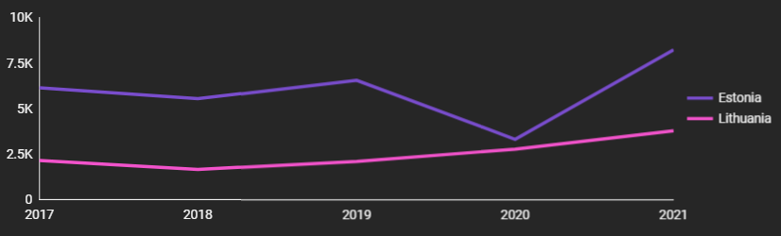
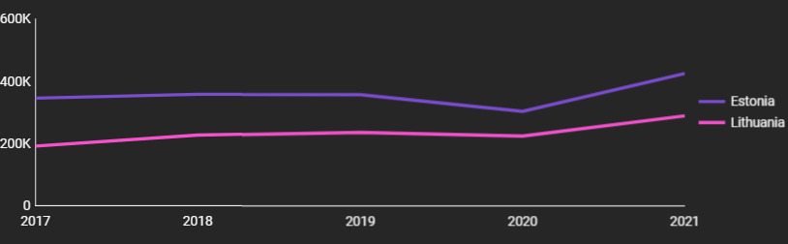
Country performance measures
Profit per employee
Return per employee
Notes:
When we observe…….. -
Estonia is better in both metrics by a significant margin.
Therefore, the safe conclusion was to look for the best performer in both countries.

Slide 13
Firm analysis

Slide 14
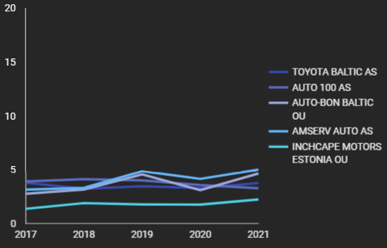
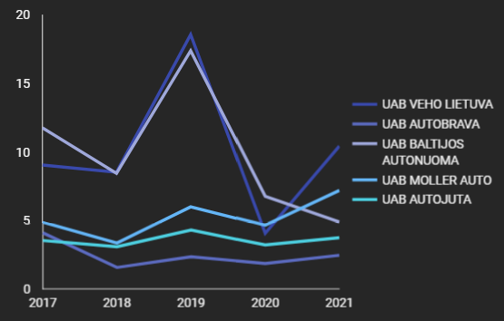
Firm performance measures
Top 5 performers
Estonia
Lithuania
Notes:
As already previously mentioned though, return on assets is the most important metric. The return per asset cannot be changed with a simple restructuring of a company. Rent costs are what they are in each country; one firm cannot influence that. Therefore, we compare the top 5 revenue-earning companies in each country.
So… By already looking at this graph can you guess which country is chosen because of its performance? The main interest is attracted by Lithuanian companies. Although if the potential firm isn’t taken from the first top 3 performers in LT, Estonia is in good contention again.

Slide 15
Top 5 Lithuanian company return on assets
9,07
8,64
4,88
3,54
2,36
UAB VEHO LIETUVA
UAD BALTIJOS AUTONUOMA
UAB MOLLER AUTO
UAB AUTOJUTA
UAB AUTOBRAVA
17.11% market share
(Market leader)
12.57% market share
5.14% market share
4.8% market share
12.93% market share
Notes:
Here I took as the most important 2 metrics: asset efficiency (again of course :D) and market share.
I took market share just to see if a company has over 10% market share, because in the car dealership sector that can be considered already a big market share, since car dealerships usually have rights to sell certain cars. And since PE company earns from valuation differences: It doesn’t seem worth ir to try to increase 15% market share to 20%, if with the same money at least twice the growth can be achieved by buying a smaller market owner.
Because of this, the 2 best performers in return per assets are let off. So, what are we left with?

Slide 16
Top 5 Lithuanian company return on assets
9,07
8,64
4,88
3,54
2,36
UAB VEHO LIETUVA
UAD BALTIJOS AUTONUOMA
UAB MOLLER AUTO
UAB AUTOJUTA
UAB AUTOBRAVA
17.11% market share
(Market leader)
12.57% market share
5.14% market share
4.8% market share
12.93% market share
Notes:
UAB Moller Auto. Additionally, by checking the dashboard to see if the company is stable enough it became clear that Moller Auto is the best option for PE to take on. There is a lot of space for potential growth for this company and a potential to earn big money.

Slide 17
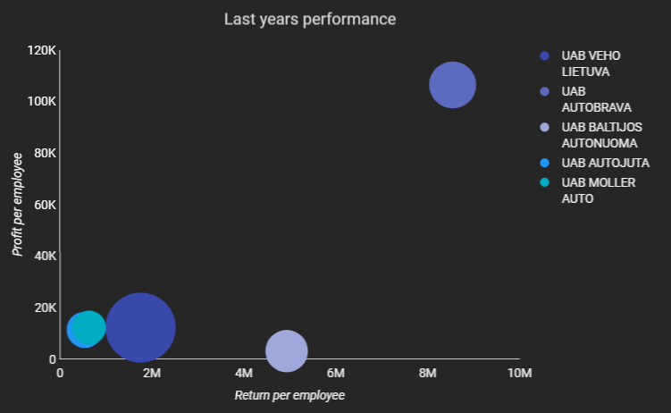
Deal analysis
UAB Moller Auto can easily get to the same levels as UAB Autobrava
If the company reaches the same performance as UAB Autobrava 13 Million EUR profit minus the investment.
Notes:
Looking at the graph we can see that UAB Moller Auto has a pretty low performance in return and profit per employee. While it is not perfect, in this case, it is kind of a good thing, because from a quick search on google it became clear that the company sells Audi and Volkswagen group cars. Since Audi can be considered as a premium brand and VW – as a middle-class brand the company can achieve much better results than UAB AUTOBRAVA, which is a company with 2x more revenue, while only selling Mercedes brand cars. Maybe the return per employee will not be as large since the markup cant be that big, but turnover definitely can increase to the same levels, and potentially even surpass it. Therefore increasing turnover and EBIT would lead to bigger enterprise valuation. In a hypothetical scenario, where after 5 years after the acquisition, if the company has reached the same levels as AUTOBRAVA, the enterprise valuation could increase from 27 million that it would be worth today, to 40 million, leaving 13 million EUR as a profit for PE company, of course minus investment costs that would be put in the company. But since the inner structure and ebit margin could be upgraded in the process, the firm could look at well above 40 Million valuation.

